Slide 1
Renaissance Period
Copernicus (1473-1543)
Tycho Brahe (1546-1601)
Johannes Kepler (1571-1630)
Galileo (1564-1642)
Medicine:
Andreas Vesalius (1514-1564) – Father of Anatomy
Ambroise Pare (1517-1590)
Medical Chemistry:
Paracelsus (1493-1541)
Technology:
Johannes Gutenberg (1398-1463)
Leonardo da Vinci (1452-1519)

Slide 2
Renaissance Technological Progress
Man has been developing various techniques for his survival since stone age.
Technology refers- ‘ways of making or doing things’
During Renaissance there were major innovations and inventions occurred.
Technological discoveries transformed the mechanism of human life from primitive hand-made work into a machine made which led to the rise of modern science.

Slide 3
Technological development brought about rapid development in human thinking during the period of Renaissance.
Printing Technology was the another important technique which invented by Johann Gutenberg of Germany in 1445.
Leonardo-da-Vinci who practically studied the art, architecture, sculpture, mathematics which contributed much to the progress of technology.

Slide 4
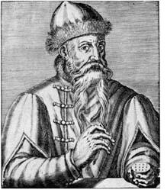
Johann Gutenberg (1397-1468)
He started his working life as a merchant, but then involved into work as a blaksmith and goldsmith.
Invention of printing press in Europe in the middle of the fifteenth century represents one of the greatest landmarks in human history.
Printing Press invented by him.
Earlier: Wood or Stone or metal – mode of communication
He was born at Mainz in Germany 1347

Slide 5
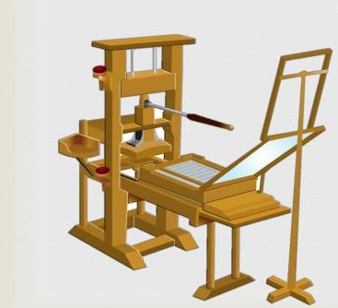
Inventing of the Printing Press in 1450
Before the printing press in 1450 books were written out by hand, mainly by monks in monasteries.
it could take one one person six months or longer to write out a book.
He mixed oil and soap together to make ink. in 1456 he made copies of the first printed book or a Bible.
the 42 line Bible was known as 'Gutenberg Bible'.

Slide 6
It was a movable type of metal printing press.
Helped spread of Catholicism
helped to spread the scientific revolution with the support of printing press.
Printing Press contributed to the growth of a middle class.
books were published with low cost, hence people wanted to learn to read. Reading led to thinking, and which promoted the communication with others.
Middle class people gained the knowledge, got awareness about their rights.
he never becomes financially rich from his idea.

Slide 7
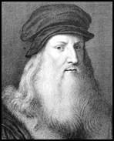
Leonardo Da Vinci
1452-1519
Renaissance Artist, painter, inventor, botanist, mathematician and Scientist.
collection of his work known as 'Leonardo da Vinci, disciple of experiment'.
Born on April 15, 1452 in small town Vinci in Italy
he described as 'Renaissance Man'
an illegitimate son to a peasant woman (Caterina) and a successful notary(Messer Piero Fruosino di Antonio da Vinci).
his full name Lionardo di ser Piero da Vinci.
he began his life facing hardship and obscurity.

Slide 8
with no privilege of a formal education, Da Vinci launched a self-education program.
by 1472 at the age of twenty he qualified master in the artists.
he become the student of Flounce a Gold-Smith, Verrocchio.
From 1506 to 1513 he was worked as an artistic advisor to the French Governor Charles D' Amboise.
during this period he painted the most renowned of his work the portrait 'Mona Lisa'

Slide 9
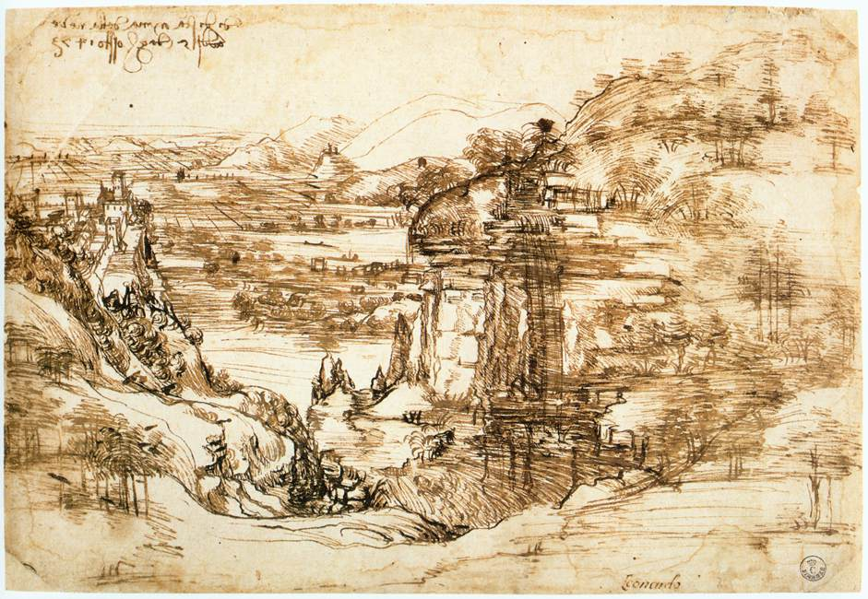
Arno Valley, Tuscany region, Italy (1473)
(Leonardo's earliest known drawing)

Slide 10
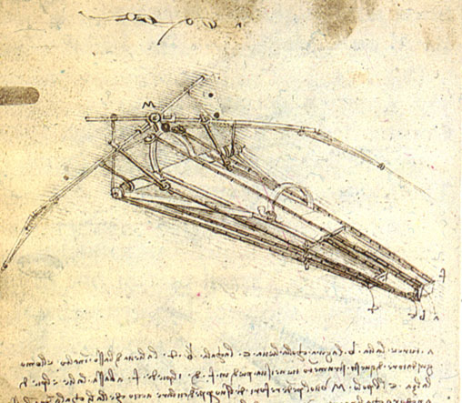
Flying Machine
He modelled or invented flying machine after his studies of bird wings but it failed due to technical error.
But his effort was the pioneer work towards the modern flight.

Slide 11
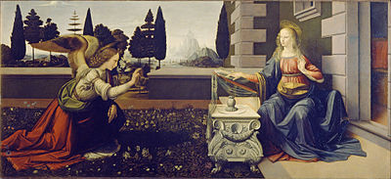
Annunciation
Painted between 1472 and 1475
One of the first painting of Leonardo
It was painted when da Vinci was still working under his master, Verrocchio.
The painting is believed to be a collaboration between da Vinci and Verrocchio.
The inspiration for the painting is from Luke 1:26-39 and depicts the angel Gabriel announcing to Mary that she would give birth to a son.

Slide 12
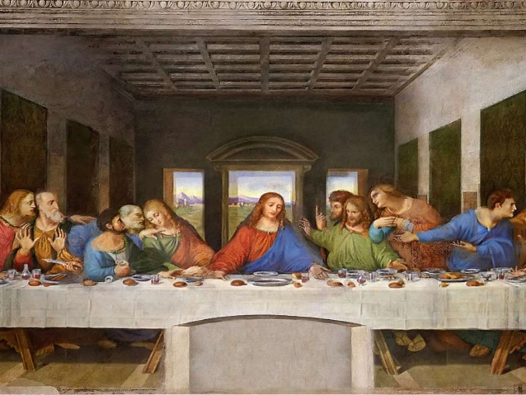
Last Super
This painting was constructed during 1495-1498.
his one of the greatest painting which represents the scene of the Last Supper of Jesus with his disciples.
Anatomical work in the expressions of Christ and the Apostles.

Slide 13
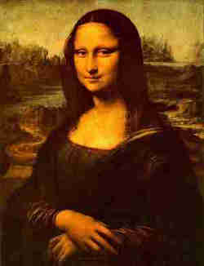
Mona Lisa
He Painted Mona Lisa painted between 1503-1506
Enigmatic Smile
The painting is a portrait of Lisa Giaconda, a wealthy Florentine merchant’s wife which was supposed to be delivered to the merchant.
Mona Lisa also known as Giaconda.

Slide 14
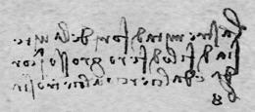

Secret Codes
He used special kind of shorthand
He usually used ‘mirror writing’ in Italian language which starting at the right side of the page and moving to the left.

Slide 15
Sigmund Freud stated about Leonardo da Vinci
“ Lenonardo da Vinci was like a man who awoke too early in the darkness, while the others were all still asleep”.

